Slide 1
MLOps architecture POC
Credit Card Fraud detection
Ajayeswar Reddy Peddyreddy
Prithvi Nuthanakalva
Tejaswi Samrat Dasari

Slide 2
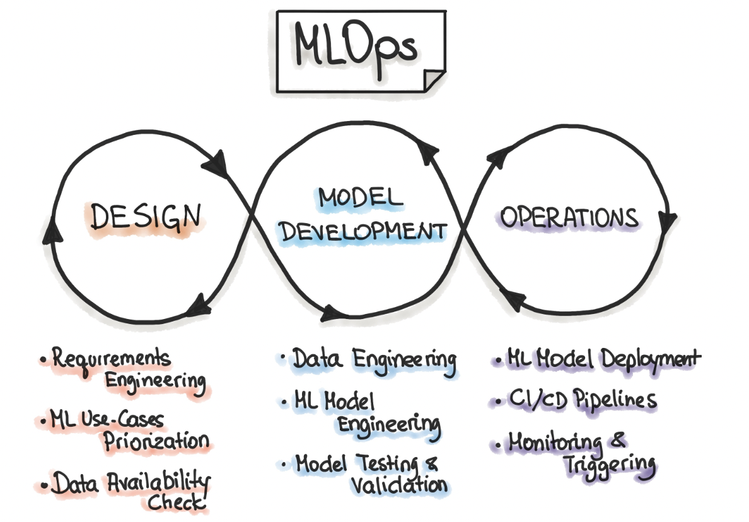
Source: Google

Slide 3
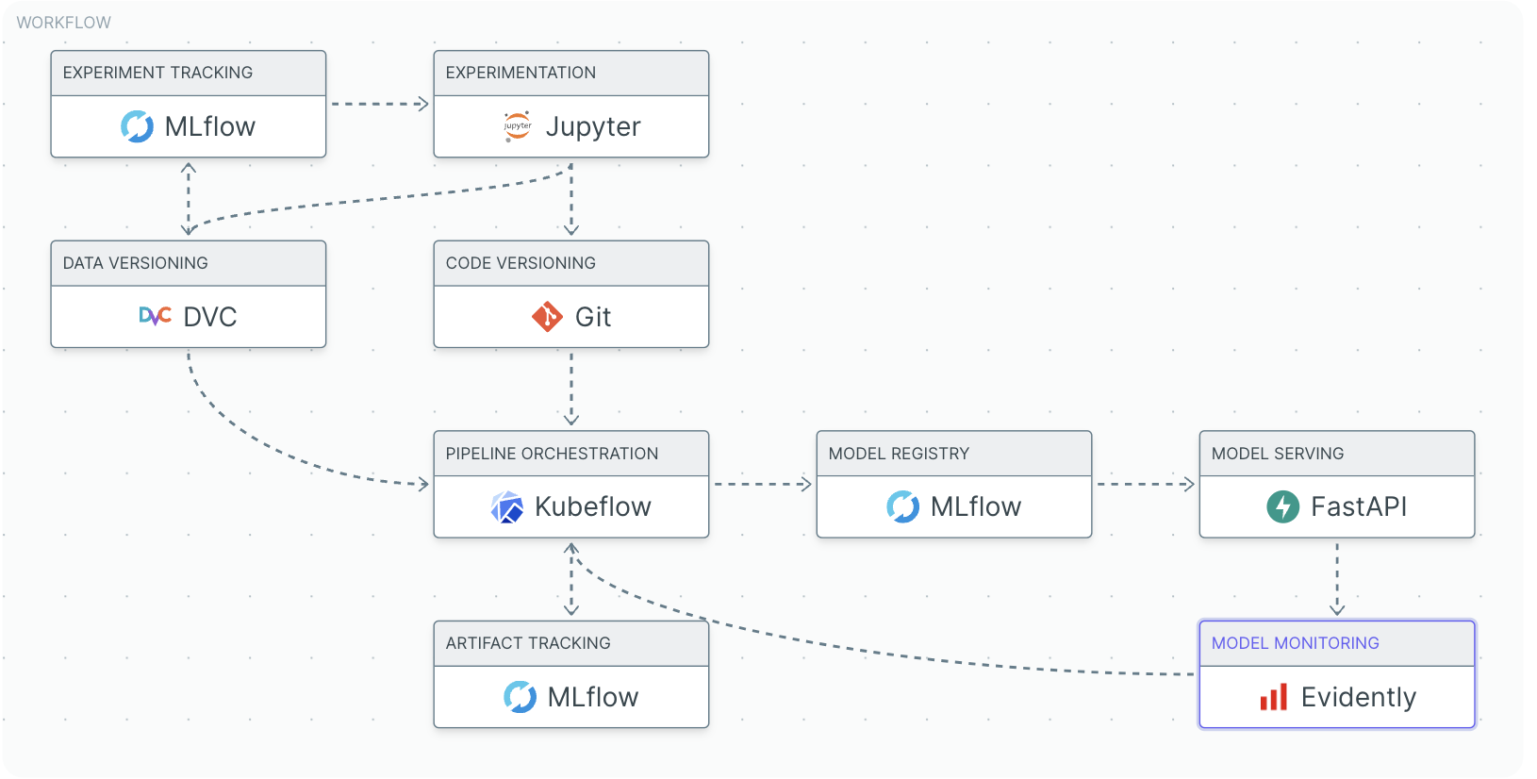

Slide 4
Experiment and Artifact tracking
Problem: Keeping track of all ML models that we develop over the course of ML model development so that we can reference what changes we made at any point later on
Tools compared: MLFlow, Weights and biases
Experiment: Train a Fraud detection ML model with a random forest model by varying hyperparameters
Train Model
Tweak hyperparameters
Retrain Model
Run inference on all trained models
Github: https://github.com/ajay-usfca/credit_fraud

Slide 5
Notes
MLFlow
. Very easy to setup locally (just need to install a single library) . Can log a model directly using sklearn.log_model, and also as an artifact . Allows for extensive logging . Emphasizes reproducibility of experiments by tracking the entire history of development process, development environment etc . Well integrated with Sklearn, PyTorch, TF, Databricks and lot more
Wandb
. Setup is little more tedious. You need to be careful about wandb/settings and .netrc where you store your api wandb key . logging a model directly is still on beta mode, need to dump into a pkl file and save as an artifact . Allows for logging but the focus is more on visualizations and dashboards . Integrated with Sklearn, PyTorch, TF, Databricks
Recommendation: MLFLow for ease of usage and more online support.

Slide 6
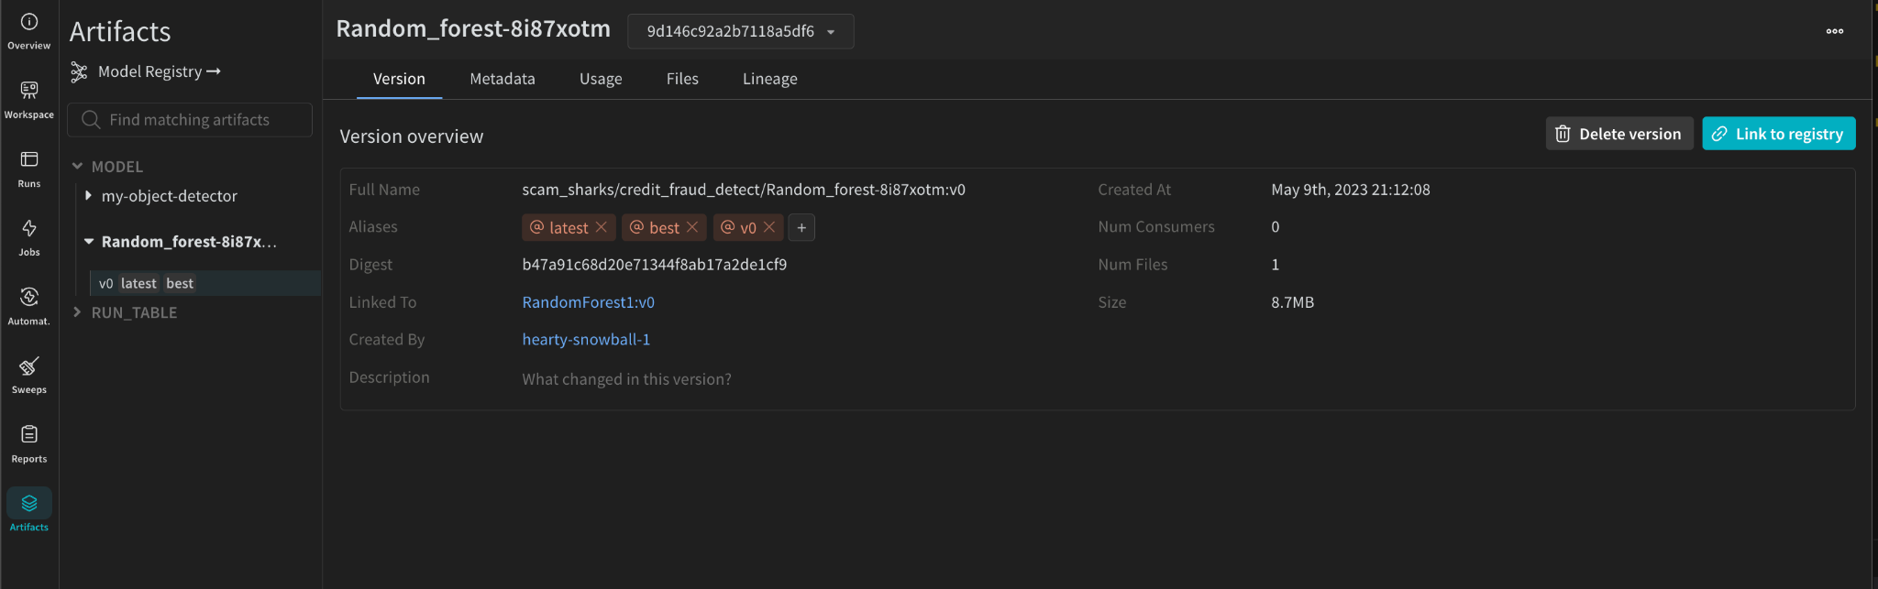
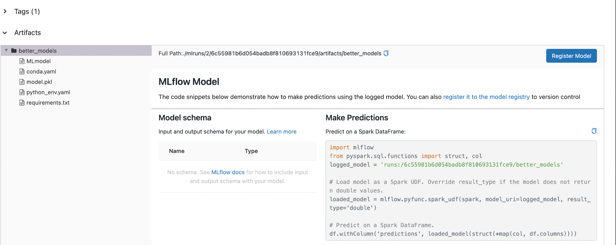

Slide 7
Data Versioning
Problem: Keeping track of data used and the corresponding models built over the course of ML model development
Tools compared: DVC and Neptune.ai
Experiment: Train a Fraud detection ML model with incremental datasets:
Train Model
Update Datasets
Retrain Model
Run inference on all trained models
Github: https://github.com/prith189/MLOps/tree/main/DataVersioning

Slide 8
Notes
DVC:
Quick to learn and setup
Intuitive as syntax is tightly coupled with git
Integrates with multiple data storage options
Easily track datasets and switch between them
Neptune
Quick to learn and setup
Simple Python library
Has a UI, which makes it easier to visually examine the various versions
Easier to tag data with their corresponding models
Recommendation: DVC as it is easy to keep a version history of the actual data used, and easy to switch

Slide 9
Data Quality
Task : To explore data quality tools
Tools compared : Great Expectations and Deepchecks
We have used fraud detection dataset. Added checks on data quality using both the above mentioned tools.

Slide 10
Notes
Great Expectations
Low code (deepchecks even low code than GE), most checks are inbuilt methods.
Build docs to infer the success of expectations.
Interactive notebooks created by the library to edit the expectations.
Multiple data sources can be added to the suite (MySQL, Spark, Bigquery)
No modelling checks.
No checks for image and text data.
Deepchecks
Both model drift and data drift checks
Less code compared to Great expectations to get results of numerous inbuilt validations.
More suitable for computer vision and NLP tasks.
Has interactive plots, with 3 levels of status - alert, success, failure.
Setup is easier compared to Great expectations.
Recommendation: Very task specific, if checks on model are also needed I’d prefer Deepchecks, else great expectations especially for tabular data.

Slide 11
ML Pipelines
Problem: Build a ML pipeline consisting of a set of tasks, where the tasks are defined as a DAG, and the output of a task feeds into a subsequent task in the DAG
Tools compared: MetaFlow and KubeFlow
Experiment: Build a ML training and inference pipeline for fraud detection. Tasks include:
(a) Data ingestion
(b) Model Training (multiple)
(c) Choosing best model
(d) Inference
Github: https://github.com/prith189/MLOps/tree/main/Pipeline

Slide 12
Notes
Metaflow:
Very easy to setup (just install one library)
Tutorials are easily understandable, and therefore easy to implement
Functionality restricted to pipelines
Was able to successfully setup a parallel training pipeline locally
Kubeflow
Setup is a bit more involved (requires kubernetes cluster setup as it is tightly integrated with it)
Each task is run on a different container
Steep learning curve
Extensive functionality not restricted to pipelines, has support for production grade inference
Was only partially able to setup a parallel training pipeline locally
Recommendation: Metaflow for ease of setup and simpler learning curve

Slide 13
Deployment
Task : To explore various deployment choices.
Tools : FastAPI, Flask, Streamlit.
We have deployed same ML models using all these frameworks. POST requests made to FastAPI and Flask to infer the results of the model.

Slide 14
Notes
Flask & Fast API
Both RESTful APIs, FastAPI is preferred faster performance requirements
No UI for Flask, need to use service like Postman to test the APIs.
To deploy, we need to employ cloud instances to host the service, unlike streamlit which has its own cloud deployment setup.
FastAPI has async await features
Easy documentation generation using FastAPI
Streamlit
No need of separate UI dev, most of it can be done using simple python.
Has a free cloud deployment service called streamlit share for one project with little to no setup.
Recommendation: Streamlit to demo a POC with no time, else FastAPI for production use cases.

Slide 15
Model monitoring
Problem: Machine learning models are different from other software applications as they are not resilient to changes in data distribution over time. It is necessary to continuously monitor the data and performance of models deployed in production to ensure their effectiveness over time.
Tools compared: Evidently, Alibit detect
Experiment: Train a Fraud detection ML model with historic data. Using this performance and data as reference, check for drift on the new data

Slide 16
Notes
Evidently AI
. Focus is more on monitoring performance and detecting drift over time
. Feature rich reports, works well with fewer lines of code for tabular data and traditional ML algorithms
. Better choice in terms of offline tracking as it it platform agnostic
. Integrations with MLFlow, airflow
Alibi detect
. Focus is more on anomaly/outlier detection in real-time
. Richer data types(time series, images, graphs) and statistical tests available
. For real-time detection, the model needs to be served on Seldon Core framework
Recommendation: Evidently is a great and more flexible all-round choice unless real-time detection is a must

Slide 17
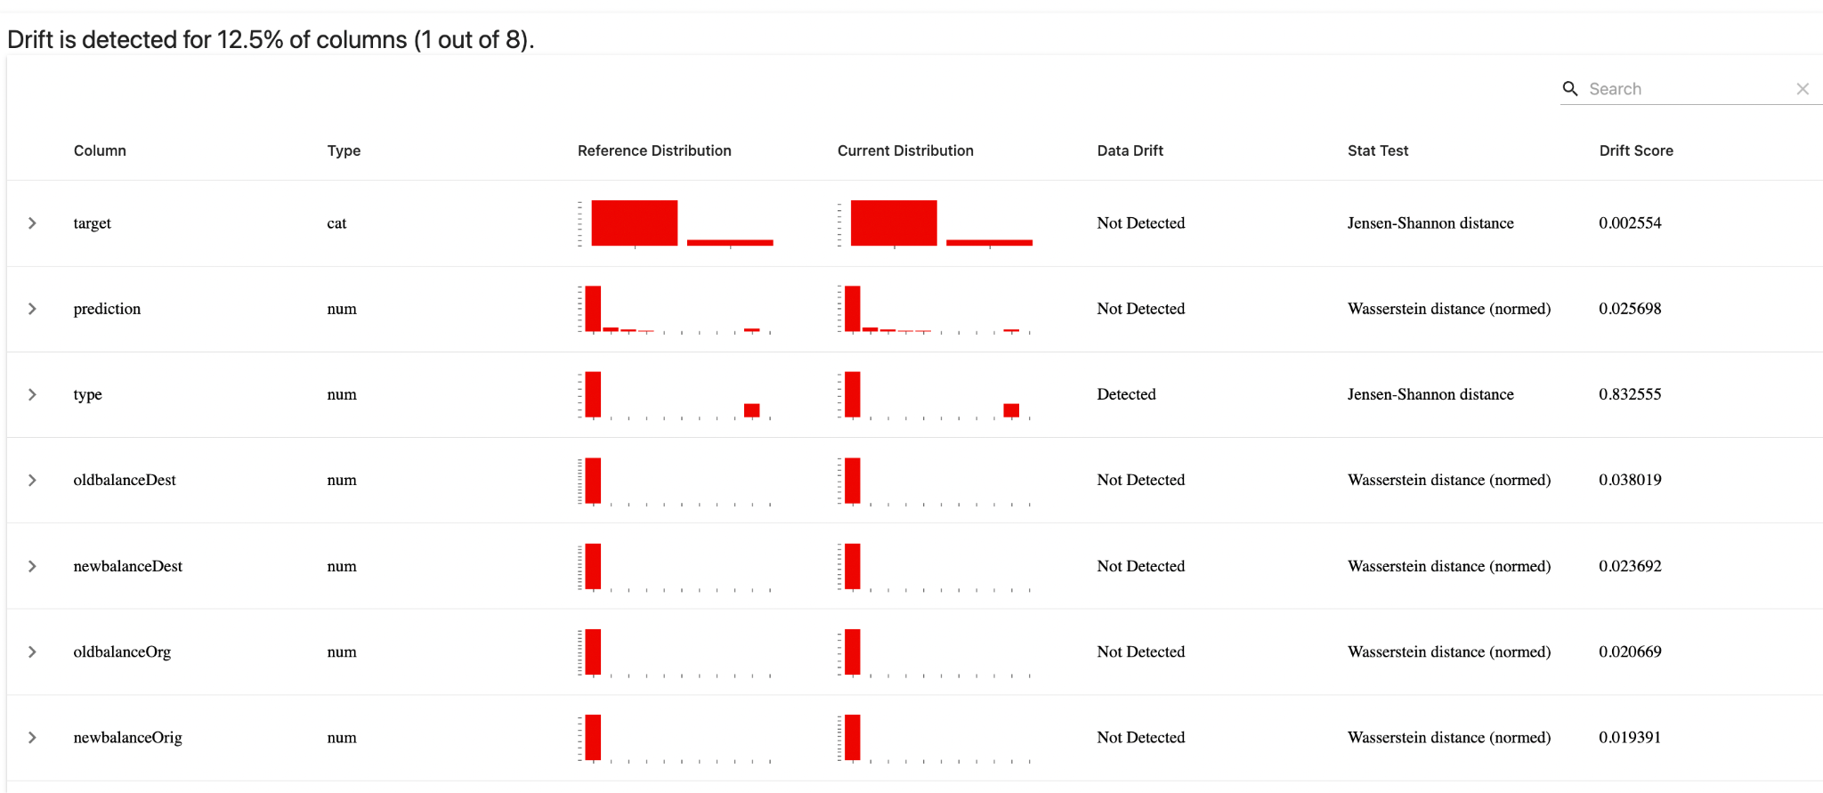
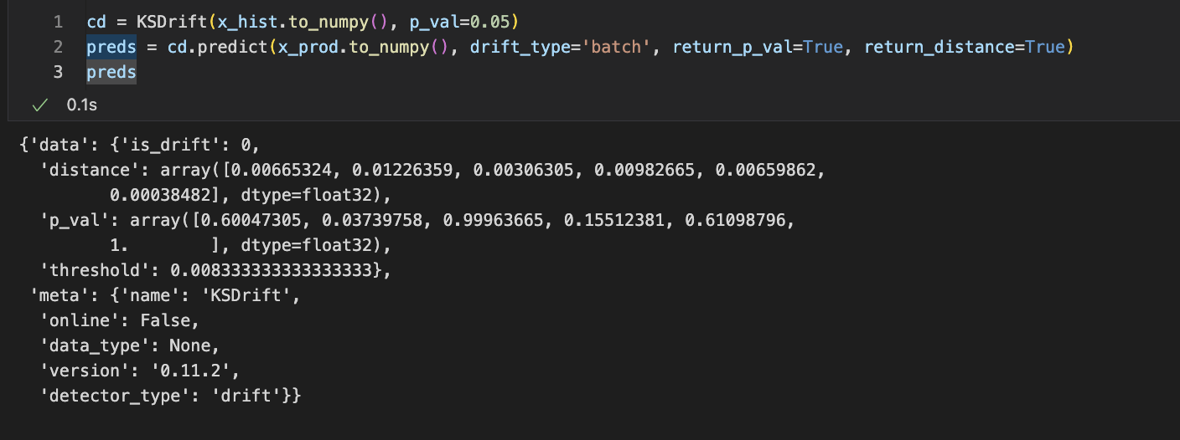

Slide 18
CI/CD, Linting and Coding Style
GitHub Actions
. Cloud based
. Tightly coupled with github thus easy to manage workflows from the repository
. Easy to set-up but not as customizable
Jenkins
. Open source automation serve
. Highly customizable
. Needs more maintenance
Recommendation: If it is a personal project, GitHub actions for the ease of set-up, but if it’s part of an organization then Jenkins since it supports various plugins
. Flake8 for linting as it is a combination of several linters like PyFlakes, PycodeStyle and McCabe
. PEP8 for coding style : Just because it is widely used and accepted standard

